Slide 1
Security: The Dark Side of Approximate Computing?
Francesco Regazzoni, Cesare Alippi, and Ilia Polian
Presented by: John Morin, Jaxon Brown, Timothy Dwyer

Slide 2
Main Idea
Paper summary:
Approximate computing is vulnerable to multiple hardware security manipulations and requires a solid understanding of security properties to be implemented safely
Paper objective:
Not to provide answers about whether certain implementations are more or less secure, but to identify security implications of approximate computing

Slide 3
Security
Security of device is equal to that of its weakest element
Often weakest point is hardware
Hardware threats introduced during circuit design, manufacturing, and operation
Hardware Security Threats:
Confidentiality (reverse engineering)
Integrity (hardware trojans)
Authenticity (circuit cloning and counterfeiting)
Notes:
Attacks can target various aspects of a system:
communication links, the software running on it, the humans using the applications.
system’s hardware is increasingly considered its weakest point, as attacks are increasingly targeting the physical implementation of security-relevant tasks
Counter-measures can be costly, underestimated, or perceived as unnecessary
Hardware security threats may be introduced throughout the entire design processes, from rouge employees/subcontractors in the design process, to malicious consumers of the final product
Confidentiality:
Circuits can be costly to design and implement resulting in extremely valuable IP assets for companies
If a competitor can infer the netlist, they may steal the IP to take advantage of competitors designs
Typically these attacks come in the form of reverse engineering
Integrity:
Attacks on the integrity of a system deliberately modify the initial design with the goal of altering the behavior of the circuit
Results of an attack on the integrity of a system include information leaks and denial of service
Hardware trojans are used to attack the integrity of a system and can be introduced at several points of the design chain (specification of parameters, design of circuit itself, CAD tools which insert additional circuitry at a foundry, inserted in the IP composing the design)
Authenticity:
Similar to confidentiality, attackers interested in the IP design by other companies.
Attacks on authenticity come in the form of circuit cloning and counterfeiting.
In this case, overproduction, re-selling of old and used circuits, and un-authorized fabrication of reverse engineered circuits enable this type of threat
ning on it, and the humans using such applications. However, the system’s hardware is increasingly considered its Achilles’s heel, as an increasing number of attacks targeting the physical implementation of security-relevant functions are proposed.

Slide 4
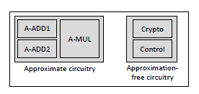
Reverse Engineering
Threat largely depends on the ability of attacker:
Depackaging, pattern matching
Reverse engineering in the context of Approx. Computing:
Inexact computations could complicate life of attacker - Distinguishing between approximation - Control flow of approx. vs precise counterparts
Configurable systems will have directly identifiable critical blocks - Certain operations need to be precise - limitations on self-adaptive approximation
Imperfectly reverse engineered circuit regarded as “approximate” - Cost/time reduced to reverse engineer
Notes:
Well equipped attacker may depackage and take high resolution photographs of each layer of circuit,
Machine learning and pattern matching algorithms can derive original circuit behavior, basic blocks or structures like (finite state machines or control flows), original architecture or reconstruct original netlist
Inexact computations:
Attacker may not be able to distinguish which approximation is selected.
May not easily identify known structures, since control flow can be significantly different between approximate and precise counterparts.
Directly identifiable critical operations
Critical operations, such as Cryptographic algorithms, can’t work with approximation. They will therefore lack any reconfigurable circuitry and be directly identifiable
Consequently: self-adaptive approximate circuits can not be used when implementing cryptographic operations
An example of this is seen in the figure:
Reverse engineered “approximate”
Permitting tolerance in the same way as approximate computing does allows attackers to reverse engineer quicker and cheaper.

Slide 5
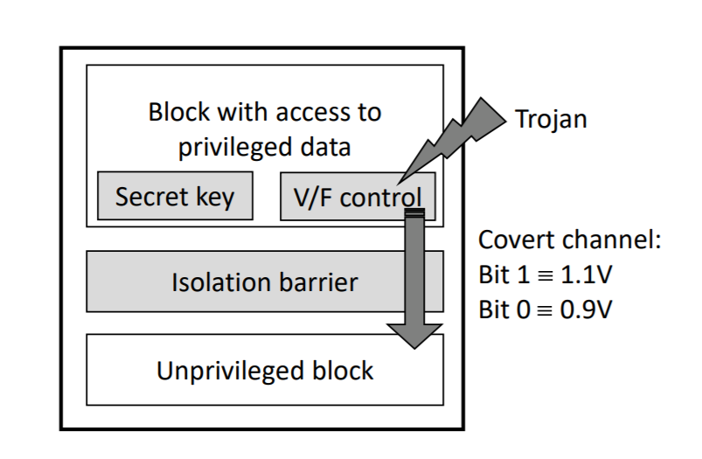
Hardware Trojans
Background: Small, simple circuitry placed inside circuit to maliciously control hardware. Rely on small size and low power-consumption in complex circuits to avoid detection
Error tolerance of approximate computing allows for certain information leakages
Can inject errors into values so device ignored them but external malicious parties can interpret data

Slide 6
Hardware Trojans (Defenses)
Possible to make more resilient to errors
Force trojans to increase in complexity
Increases size and power consumption, therefore more detectable

Slide 7
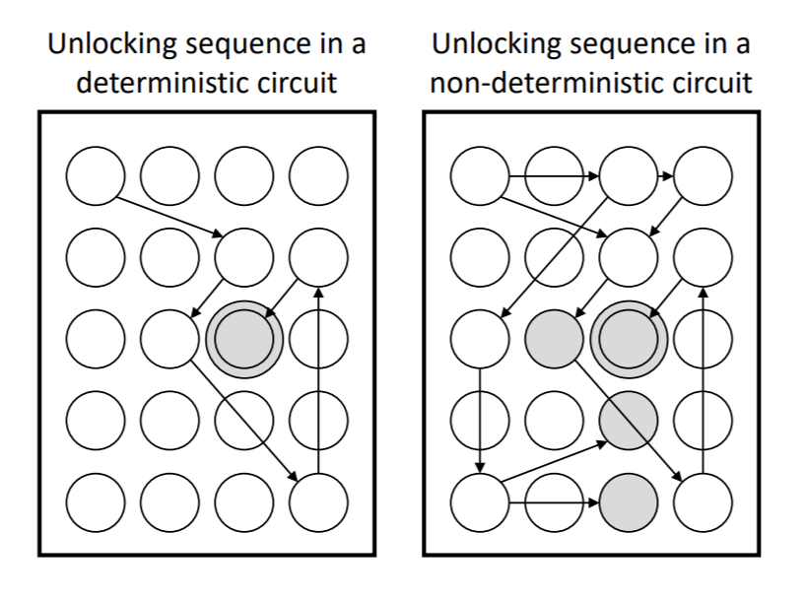
Cloning and Counterfeiting
Background: Accessing a circuit and copying its functionality to illegally reproduce devices
Metering: circuit only becomes functional once an unlocking sequence is applied to inputs
Approximate circuits aim to allow multiple paths to same outcome, opposite of locking sequence
Results in false negative or positive permissions
Possible fix - Use combination of approximate and exact?

Slide 8
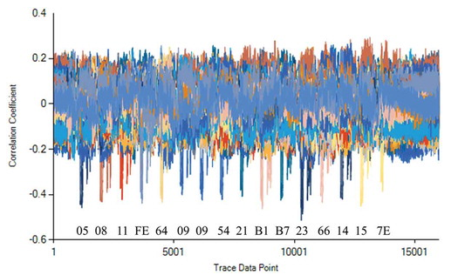
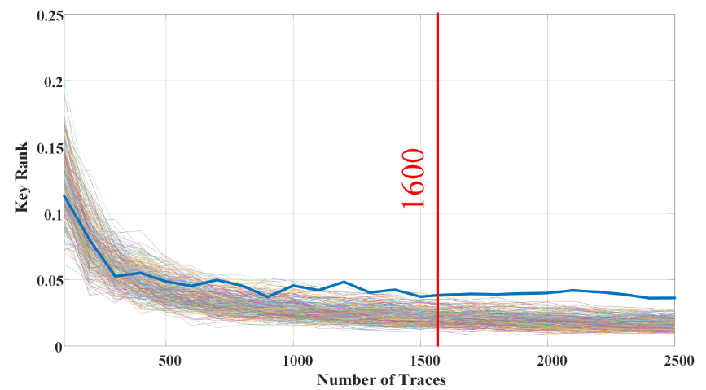
Passive Side-Channel Analysis
A Passive Side channel attack watches a trace or power usage of the system
The target of the attack is typically something like an encryption key that is not readable
The power usage is monitored and logged, and power usage spikes are detected and associated with possible bytes in a key

Slide 9
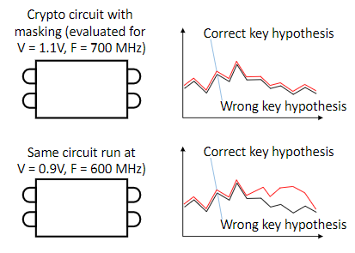
Passive Side-Channel Analysis
Major difference between an approximate circuit and a traditional circuit is that security verification techniques are well developed for traditional circuits.
Approximate circuits often have voltage scaling systems to allow them to work at different levels of voltage, frequency, and precision.
Approximate circuits would need to be validated at ALL operating points
Security verification techniques need to be developed for approximate circuits, including conceptual equivalents to the statistics used in traditional circuits
Encryption Key Leaked

Slide 10
Passive Side-Channel Analysis
On the other hand!
Since approximate computing may not always have the same power profile for the same computation, this could confuse the attacker / further obfuscate the secret
In some cryptography applications, multipliers are used that need to be constant time in order to prevent leaking of secrets.
It is more straightforward and performant to implement a constant time approximate multiplier
The attacker might have to analyze this for each voltage level, significantly increasing the complexity of extracting a key

Slide 11
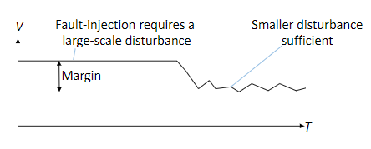
Active Attacks
Approximate Circuits often operate very close to their absolute operational limits.
Smaller disturbances are needed to induce errors
Error detection and correction is typically used as a countermeasure to fault injection attacks
This will be more complicated with Approximate circuits, since they already have some amount of error
On the other hand:
Approximate circuits are generally simpler than traditional circuits
This can make active attacks more difficult and expensive due to the need for more precise equipment to carry out the attack.
Attacks witch require well defined fault patterns could also be more difficult

Slide 12
Questions
Why would approximate computing be susceptible to reverse engineering?
Configurable systems will have directly identifiable critical blocks
Control flow of approximate circuits may be significant different from precise counterpart
Imperfectly reverse engineered circuit regarded as “approximate”
a & c
Why would approximate computing be susceptible to hardware trojans?
The increased error tolerance could be exploited to communicate external messages
Increased errors hide the power consumption of the trojans
High error tolerance requires higher complexity trojans which are better at hiding
Error “hiccups” can be distorted to mask the trojans interference
Which are not reasons that a passive side channel attack would be more effective against an approximate circuit? (Choose all that apply)
Approximate circuit verification techniques haven’t been fully developed yet
Dynamic voltage scaling can make the power response of a circuit more complex
Approximate circuits may not be verified for all possible operating points in a dynamic voltage scaling circuit
Constant time multipliers are easier to implement as approximate multipliers

